Slide 1
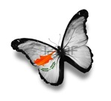
SEA CELEBRATIONS
Dimosio kai Koinotiko Nipiagogeio Empas
May 2015

Slide 2
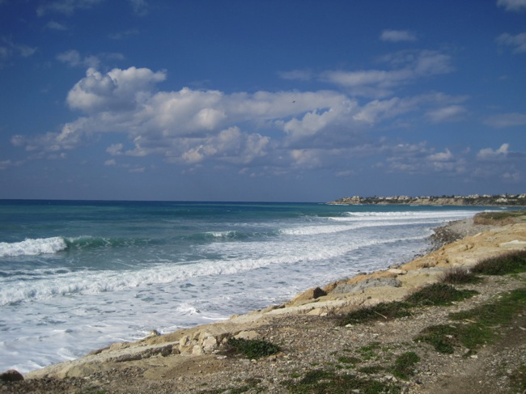
The sea near Pafos

Slide 3
Petra tou Romiou (Rock of the Greek)

Slide 4
The word “sea” in 5 languages

Slide 5
Visiting the sea

Slide 6
There are so much to do on the beach: to look at, watch, observe, research, explore, collect things, play, do sunbath, build castle from sand…
researching

Slide 7
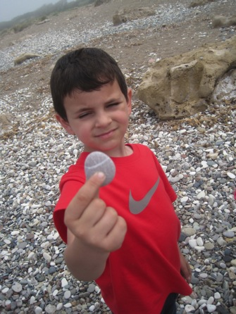
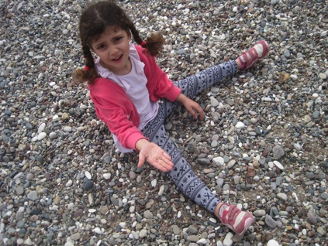
exploring

Slide 8
At the seaside
collecting

Slide 9
At the seaside
observing the water

Slide 10
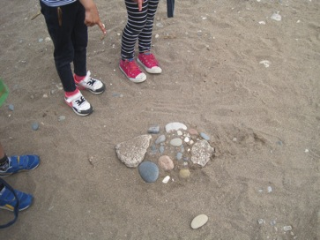
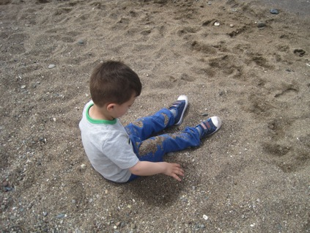
playing with sand and stones

Slide 11
At the seaside
playing and feeling nice

Slide 12
At the seaside
The sea is so quiet today! There are no waves at all!
It is so foggy here!

Slide 13
Keep the beach clean, please!

Slide 14
Brainstorming

Slide 15
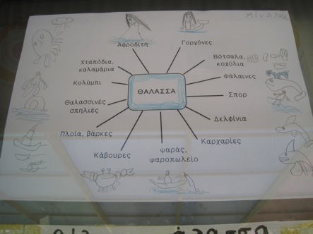
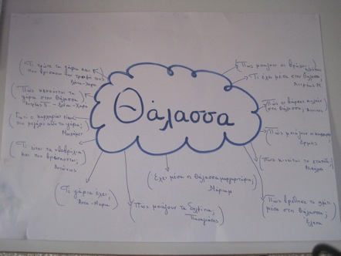
Histograms

Slide 16
Children wanted to learn about:
Sea animals
Sea transportation (boats, ships, submarines)
Sea sports
Sea occupations (fishermen, sailors, divers)
Pirates
Mermaids
God of Sea in ancient Greek mythology
Goddess Aphrodite
Sea food
Sea plants
Pearl
Underwater life
Songs, fairy tales

Slide 17
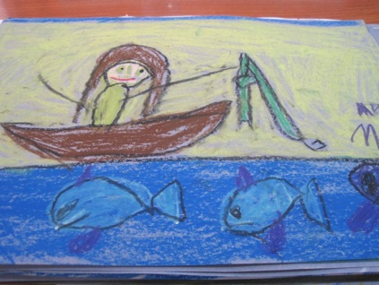
Art activities
with pastels

Slide 18
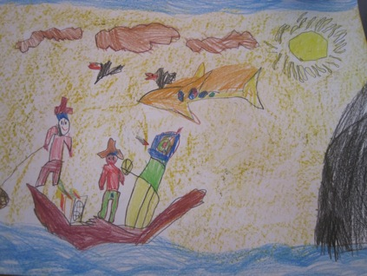
Art activities
with pencils

Slide 19
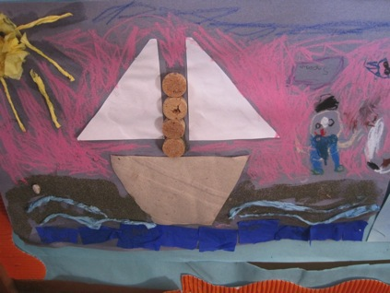
Art activities
collage with different materials

Slide 20
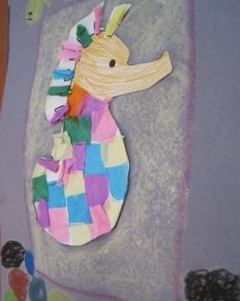
Art activities
collage with different materials

Slide 21
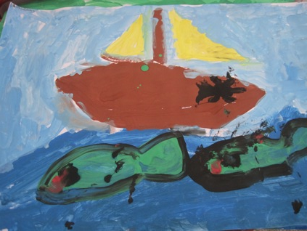
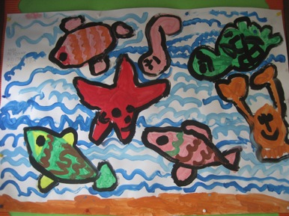
water color

Slide 22
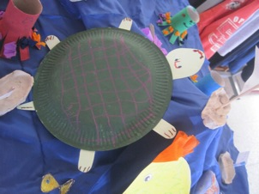
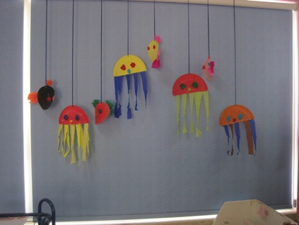
Art activities
paper plate crafts

Slide 23
Art activities
toilet paper roll crafts

Slide 24
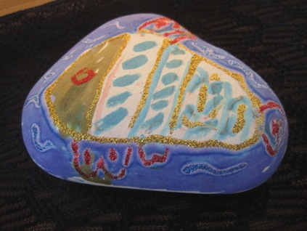
Art activities
with markers

Slide 25
Art activities
modeling

Slide 26
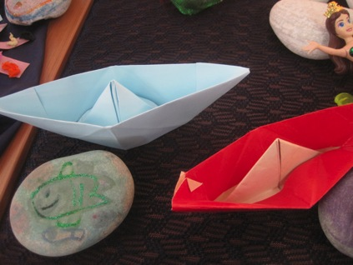
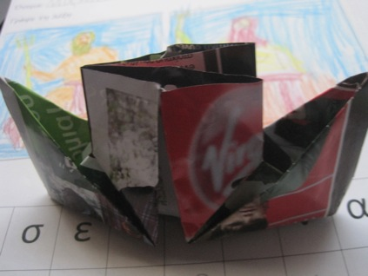
Art activities
origami

Slide 27
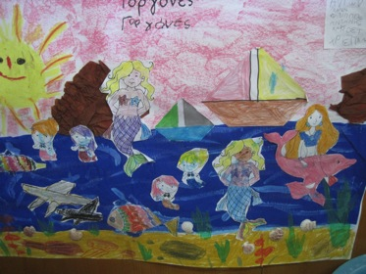
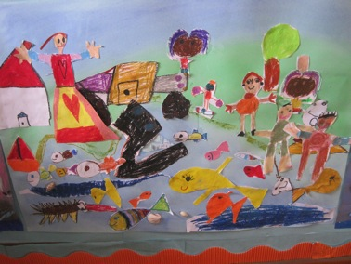
Art activities: teamwork with mixed technics

Slide 28
Art activities
play dough - plaster

Slide 29
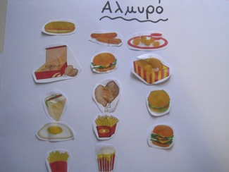
Salty or Sweet?

Slide 30
Water transportation

Slide 31
Poseidon (God of the Sea)
(His weapon was a trident, with which he could make the earth shake, causing earthquakes and shatter any object. He was second to Zeus in power amongst the gods. He created the first horse. He is also called Neptune.)

Slide 32
Aphrodite (Goddess of Beauty and Love)
(Her holly tree was the myrtle, while her holy birds were the dove, the swan and the sparrow.)

Slide 33
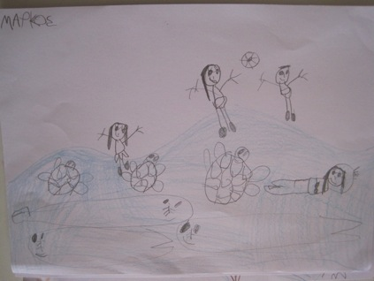
Mermaids

Slide 34
Endangered species of Mediterranean
Turtle Caretta caretta
Seal Monachus monachus

Slide 35
Thank You!

