Slide 1
EASTER CELEBRATIONS March – April 2015
Dimosio kai Koinotiko Nipiagogeio Empas

Slide 2
“Kathara Deftera” (Green Monday)
Preparations for Easter celebrations begin with “Kathara Deftera”.
It is the “Green Monday” or “Clean Monday”.
It is public holiday.
It is family festival that marks the start of the 50-day Orthodox Lenten fast which ends after midnight on Easter Saturday.
It is the beginning of leaving the sinful attitudes and non-fasting foods behind, preparing for cleanliness.
Everyone heads for the countryside with vegetarian picnic.
The Lenten fast prohibits meat, fish (except kalamari, cuttlefish, octopus and prawns), egg and any diary products – and even olive oil in the final week of the fast.
There are many kite-flying competitions. In Pafos this competition is very popular.
A lot of traditional games are played on this day.

Slide 3
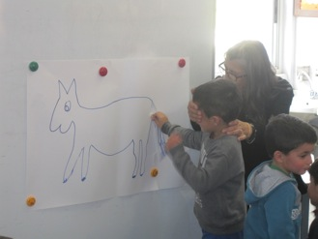
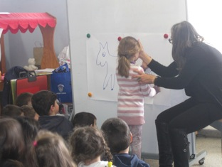
Children dance traditional dances and play traditional games

Slide 4
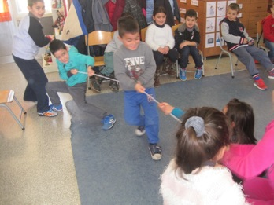
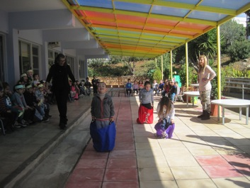
Traditional games
Schini or Dielkistinda (Rope pulling)
Sakulodromies (Sack racing)

Slide 5
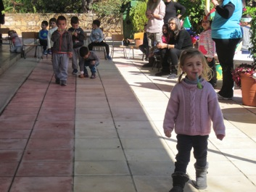
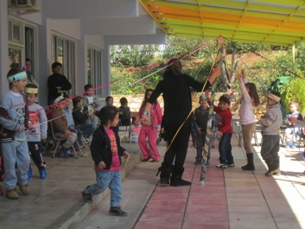
Traditional games
Avgodromies
(Egg racing)
Gaitanaki (Maypole)

Slide 6
Kite-crafts by children

Slide 7
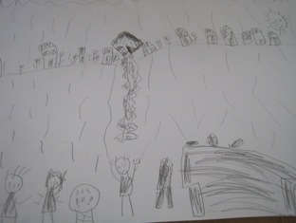
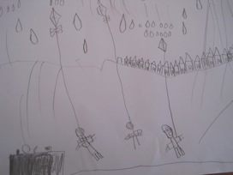
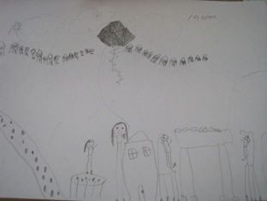
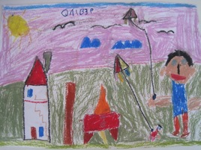
Drawing how they spent the Green Monday with their families

Slide 8
“Kathara Deftera” (Green Monday)
Except traditional games and dances, at school children learnt about vegetables, fasting food and proper diet. They spoke about food pyramid and they made it.

Slide 9
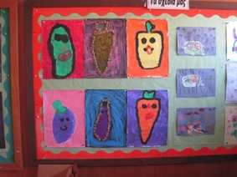
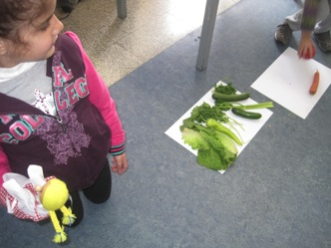
Learning about vegetables

Slide 10
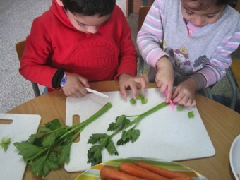
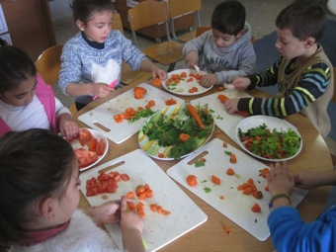
Making vegetable soup

Slide 11
Our vegetable soup is ready: Good appetite!

Slide 12
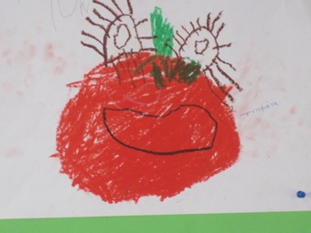
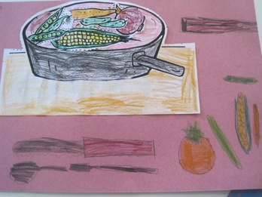
Vegetables (art activities)

Slide 13
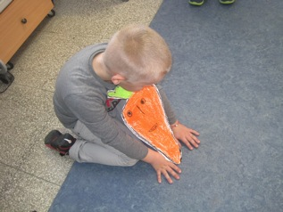
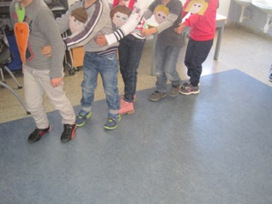
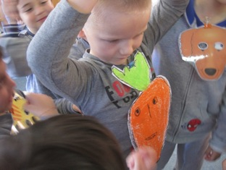
Playing drama: The Enormous Turnip (Russian folk tale)

Slide 14
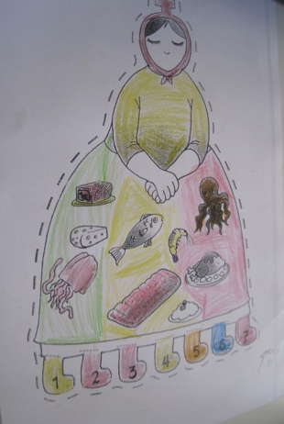
“Kyra Sarakosti” (Lady Lent)
Easter Fasting is for 50 days and is called “Sarakosti”.
“Kyra Sarakosti” is a calendar to count the 7 weeks of Lent.
A woman/paper doll is drawn on a piece of paper. Children color her, but they would not draw a mouth, because the woman is fasting and the hands are crossed as in prayer.
She also has 7 legs to represent the 7 weeks of Lent. Every Saturday one leg is cut off till she has no legs after Holy Saturday.

Slide 15
EASTER
It is a movable celebration and it is the greatest holiday of the Greek Orthodox Church.

Slide 16
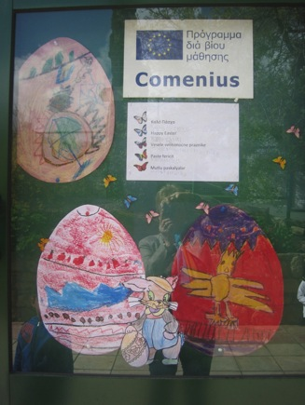
At school children celebrated Easter by:
Learning the meaning of Easter celebrations in our life.
Learning about Easter customs and traditions of our and other countries.
Learning about the life and miracles of Christ.
Listening to Byzantine psalms.
Singing Easter songs and telling poems.
Hearing fairy tales about Easter.
Watching movies about the life and miracles of Christ.
Making art activities: collages, drawings, watercolor, pastels, crafts (cards and other).
Baking the traditional Easter pie: “flaouna”.
Dancing traditional dances.
Playing traditional games of Easter.
Feeling the solemnity and happiness of these days.

Slide 17
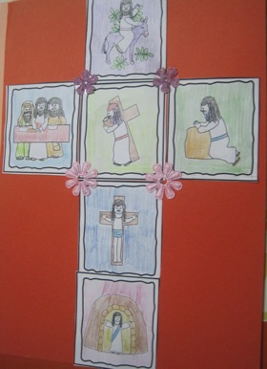
EASTER CELEBRATIONS: the HOLY WEEK Greek Cypriot Traditions
Holy week is dedicated to church going and to baking.
Every person prepares himself spiritually for Easter.

Slide 18
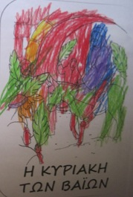
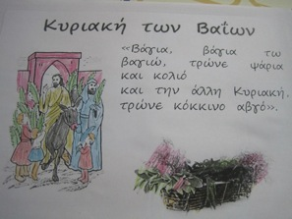
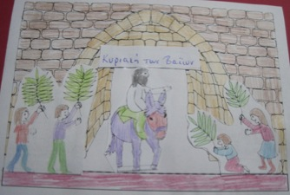
Palm Sunday
On this Sunday people take palm leaves and olive leaves to the church and follow the icon of Christ around the church in a procession commemorating Christ’s entry in Jerusalem.

Slide 19
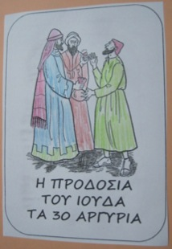
Holy Thursday
This is the day of crucifixion of Christ.
People go to church to mourn. The church’s icons are covered with black veils to show their grief.

Slide 20
Holy Thursday: Eggs
On Holy Thursday eggs are boiled and dyed red with a special root called “rizari”, to symbolize Christ’s blood falling from the cross.
Some other people paint eggs in various colors. (f.e. yellow color with yellow daisies that cover the waysides and fields during April.)

Slide 21
Holy Thursday: “Flaounes” (Cheese pies)
On Holy Thursday flaounes are baked.
They are made of dough with a cheese, eggs, raisin and mint filling, formed into triangular or square shapes.
Flaounes are so traditionally Cypriot.
They are a bit sweet and a bit savory and are made to break the fast.
They are made by every family in Cyprus to celebrate Easter.

Slide 22
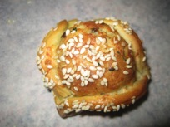
Recipe of “flaounes”
Ingredients
For The Dough
675g strong plain flour
1 sachet of easy bake yeast
1 teaspoon of salt
2 teaspoons of sugar
2 tablespoons of olive or vegetable oil
For The Cheese Filling
225g cheddar cheese or 12 oz flaouna cheese
100g halloumi cheese
1 tablespoon of flour
1 teaspoon of baking powder
1 tablespoon crushed dried mint
4 eggs lightly beaten
To Finish
1 egg beaten
sesame seeds

Slide 23
To make the flaounes
Sift flour into a large bowl and stir in the packet of yeast, the salt and the sugar.
Knead this for about 5 minutes until smooth and elastic, then put the dough into a plastic bag and leave in a warm place to rise for approximately 1 hour.
Next...
For the filling, coarsely grate your cheese, add the flour and baking power, then gradually stir in the beaten egg and seasoning until a stiff paste emerges. Keep back a little of the beaten egg, just in case the mixture is too runny. You just have to gauge it as you go along.
Then...
Divide the dough into egg shaped pieces and roll into 4 inch rounds. Place a good tablespoon of the cheesy filling into the middle of the pastry round.
Pull up the dough at 3 points to make a triangle or 4 points to make a square, you still to see the filling in the middle. Press the corners together to seal then leave to rise.
Finally…
Brush to pastry with beaten egg and sprinkle on the sesame seeds.
Bake in a hot oven, gas mark 8, 450 degrees Celsius for 12-15 minutes until the cheesy filling puffs up and the flaounes are golden in color.
Eat them warm or cold!
http://www.the-real-cyprus.com/flaounes.html

Slide 24
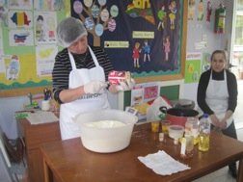
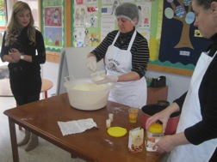
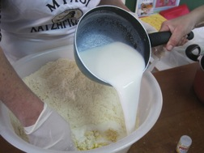
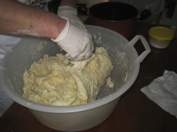
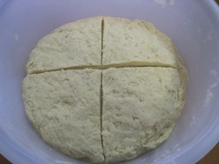
Making “flaounes” with children

Slide 25
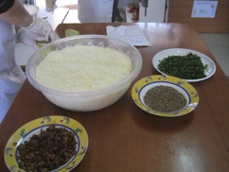
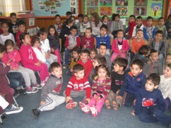
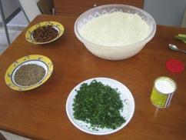
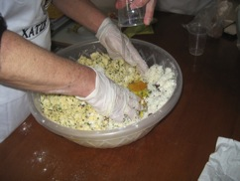
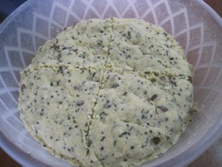
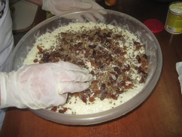
Making “flaounes” with children

Slide 26
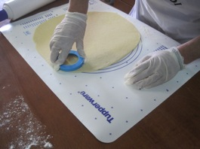
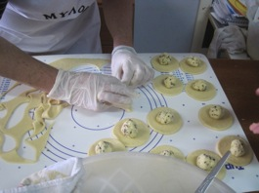
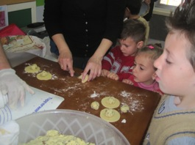
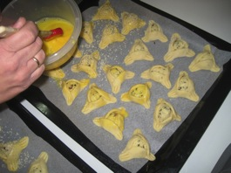
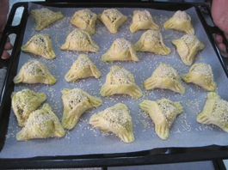
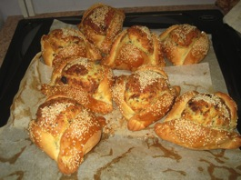
Making “flaounes” with children

Slide 27
Holy Friday: “Epitafios” (Holy Sepulcher)
On Holy Friday everyone brings flowers to the church so that the young girls can decorate the “Epitafios”, the Holy Sepulcher.
At lunchtime the traditional “Faki Xidati” (vinegar and lentil soup) is eaten, containing vinegar because it is said that when Christ asked for water on the cross He was given vinegar instead.
There is a procession around the church which starts after the evening service with the priests preceding. People follow the whole procession.

Slide 28
Holy Saturday
On Saturday morning people go to church and as soon as it is announced by the priest that Christ is no longer in the grave, the church doors and church sits are banged by the people, and all the black veils that cover the Holy icons drop.
The real sermon of resurrection happens at midnight.
Everybody goes to church and celebrates.
During the midnight sermon, special candles (“lampades”)are lit by the holy light and all people try to take the Holy Light at their houses for blessing and good luck.

Slide 29
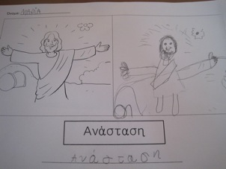
Holy Saturday
Judas, the Christ’s traitor, is burned in the church yard. This is a tradition called “Lambratzia”.
There is firework, too.
After the midnight sermon the whole family gathers together for a feast.
People eat a special kind of soup called “avgolemoni”.
They also crack the boiled dyed eggs and say “Christos Anesti”, (Christ has risen) and the response is “Alithos Anesti”(Indeed He has risen).

Slide 30
Holy Sunday
On Sunday people crack eggs again. The person who holds the last uncracked egg will be lucky.
People eat roasted lamb, flaounes and drink wine.
On the other day traditional games are played.
The celebrations continue for 3 days.

Slide 31
Our EASTER cards

Slide 32
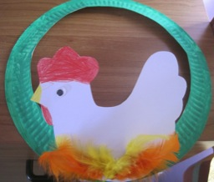
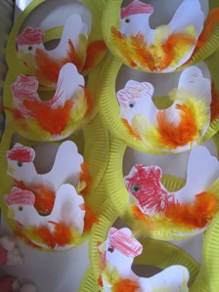
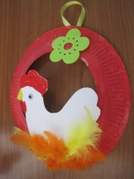
Our Easter paper plate wreaths

Slide 33
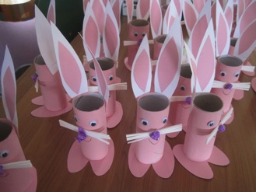
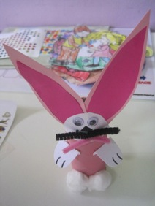
Our Easter paper roll crafts

Slide 34
Easter Art activities

Slide 35
Thank you!

